Slide 1

Heart Attack Risk Prediction Using Data Mining Techniques
Michael Jung, Sungho Kim, Caleb Jennings

Slide 2
Table of content
Introduction
Related work
Methodologies
Performances
What we learned
Future Works
References

Slide 3
Motivation & Goals
Intro
Related Works
Methodologies
Performances
What we learned
Future Works
References
Motivation
Cardiovascular disease continues to be one of the leading causes of death worldwide.
Early detection and accurate risk prediction are essential for reducing strain on healthcare systems and improving patient outcomes.
Goals 1. Identify the key risk factors for heart disease. 2. Analyze how these risk factors vary across different age groups.
Research Question
What are the significant predictors of heart attack risk, and how does the influence of these predictors vary across different age demographics?

Slide 4
Related works
Intro
Related Works
Methodologies
Performances
What we learned
Future Works
References
Logistic Regression on UCI Dataset
Used 14 features, ~300 samples
Achieved 87% accuracy
Showed LR as simple yet effective for heart disease prediction
Early Prediction Using PCA + HGA with k-Means
PCA reduced features to 2 components
Hybrid Genetic Algorithm improved clustering
Achieved 94.06% accuracy in early detection
ML with Jellyfish Optimization Algorithm
Used ANN, DT, AdaBoost, SVM + feature selection
Best accuracy: 98.47% with SVM
Showcased power of optimization in boosting ML performance
Gap: Use same prediction model to observe risk factor dynamics for age groups

Slide 5
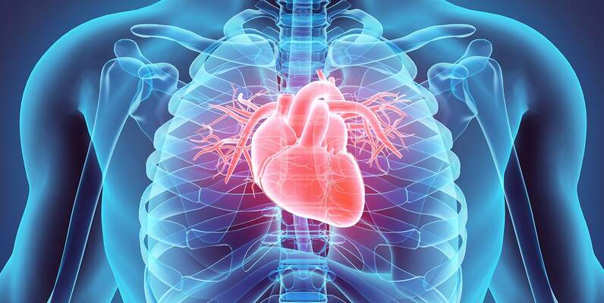
Dataset
Intro
Related Works
Methodologies
Performances
What we learned
Future Works
References
UCI Heart Disease Dataset (Cleaned)
302 unique patient instances and 14 clinical features
Includes age, sex, chest pain type, cholesterol, BP (Blood Pressure), max heart rate, etc.
There were duplicate patients > dropped duplicates to get 302 data points
No missing values
Categorical features were also shown in numerical values

Slide 6
Preprocessing
Intro
Related Works
Methodologies
Performances
What we learned
Future Works
References
1. Duplicate entries removed df.drop_duplicates()
2. Binary Feature Mapping:
Sex Male: 1, Female: 0
Fasting Blood Sugar >120: 1, ≤120: 0
Exercise-induced Angina Yes: 1, No: 0
3. Categorical Feature Mapping:
Chest Pain Type 0 = Typical, 1 = Atypical, 2 = Non-anginal
Resting ECG 0 = Normal, 1 = Abnormal, 2 = LVH
ST Segment Slope 0 = Upsloping, 1 = Flat, 2 = Down sloping
Vessels Colored Integer 0–4
Thalassemia 0 = No, 1 = Normal, 2 = Fixed Defect, 3 = Reversible Defect

Slide 7
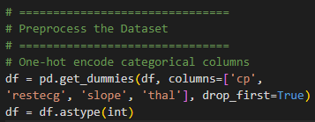
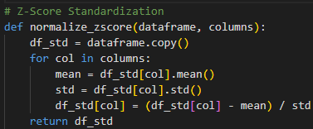
Models – Linear Regression
Intro
Related Works
Methodologies
Performances
What we learned
Future Works
References
Why Logistic Regression?
Provides clear insights into the relationship between features and the probability of heart attack through its coefficients
Serves as a strong and well-understood baseline model for comparison with more complex algorithms (RF and NN)
One-hot encode categorical features
Z-score to allow features with different scales contribute equally to the model and helps with the optimization process
Notice: 5-fold Stratified Cross Validation was applied to all models

Slide 8
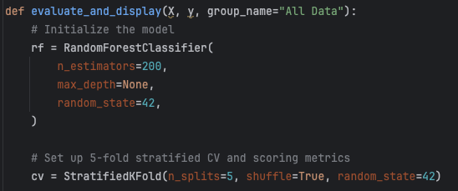
Models – Random forest
Intro
Related Works
Methodologies
Performances
What we learned
Future Works
References
No further preprocessing steps (optimal binary splitting applied for continuous features)

Slide 9
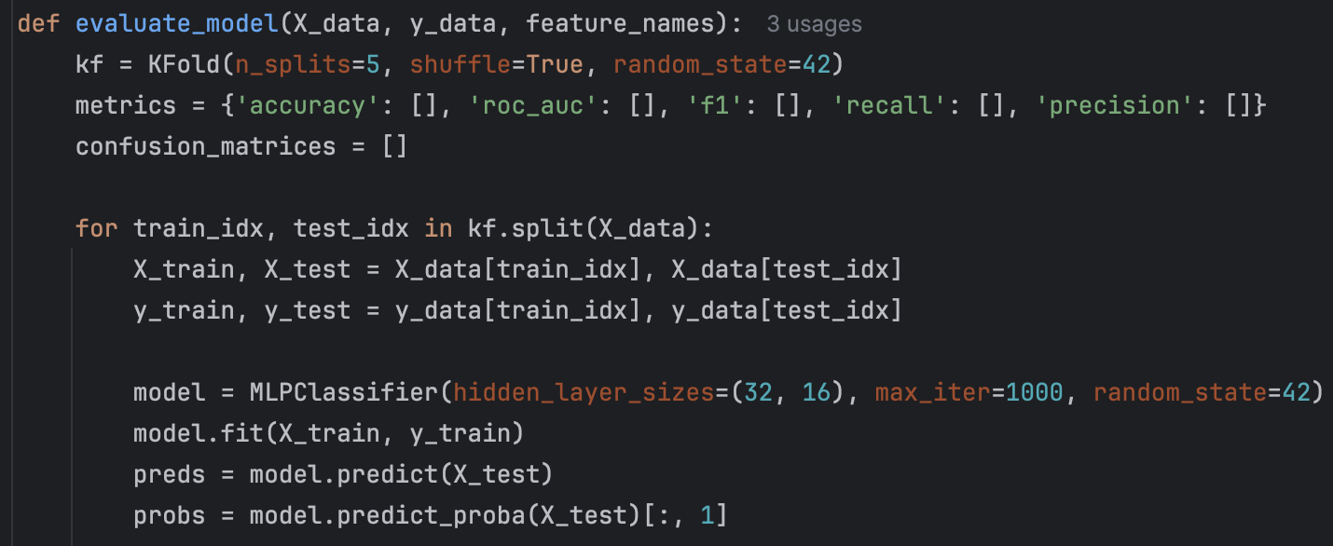
Models – neural network
Intro
Related Works
Methodologies
Performances
What we learned
Future Works
References
Model Architecture
2 hidden layers (32, 16)
Max iterations: 1000
Activation functions: ReLu*, Sigmoid
Normalization
Batch normalization attempted; data set too small to be useful
Overall Model Design
The model design requires minimum code as it is the default sklearn structure for Neural Networks
*Tanh activation function performed slightly better than ReLu

Slide 10
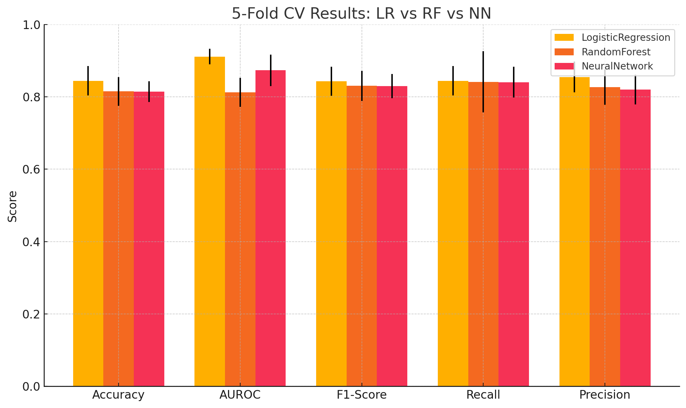
Performances: entire dataset
Intro
Related Works
Methodologies
Performances
What we learned
Future Works
References

Slide 11
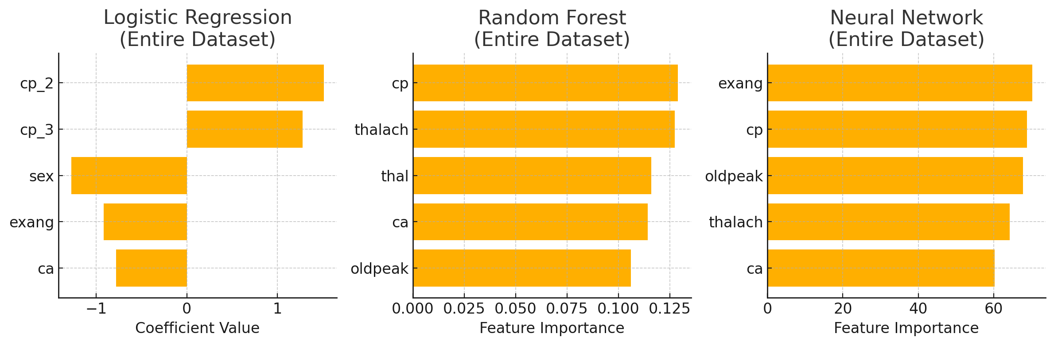
Feature importance: entire dataset
Intro
Related Works
Methodologies
Performances
What we learned
Future Works
References

Slide 12
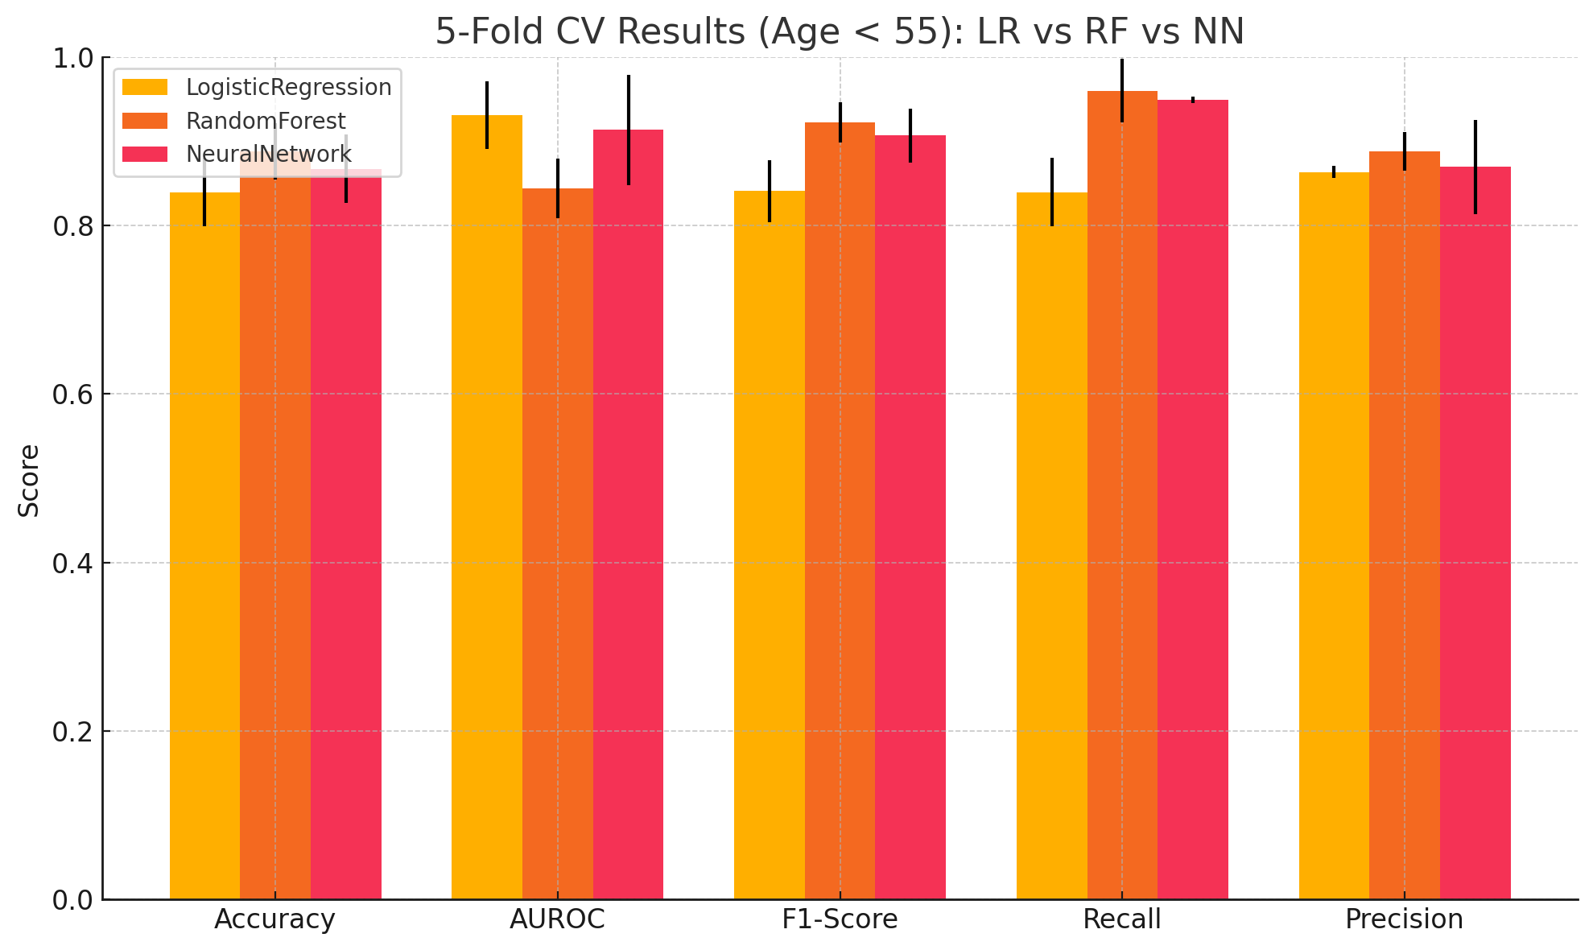
Performances: [age group < 55]
Intro
Related Works
Methodologies
Performances
What we learned
Future Works
References

Slide 13
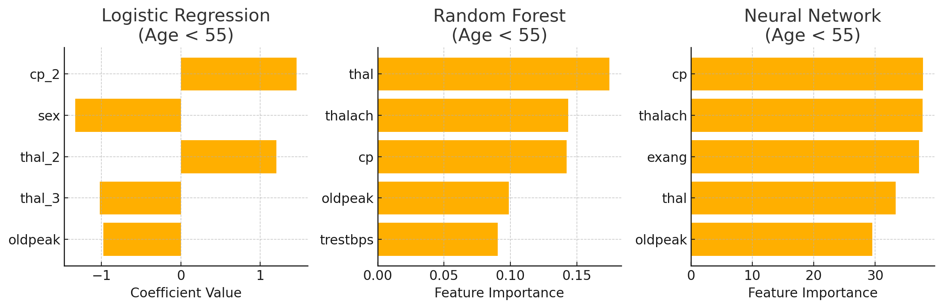
Feature importance : [age group < 55]
Intro
Related Works
Methodologies
Performances
What we learned
Future Works
References

Slide 14
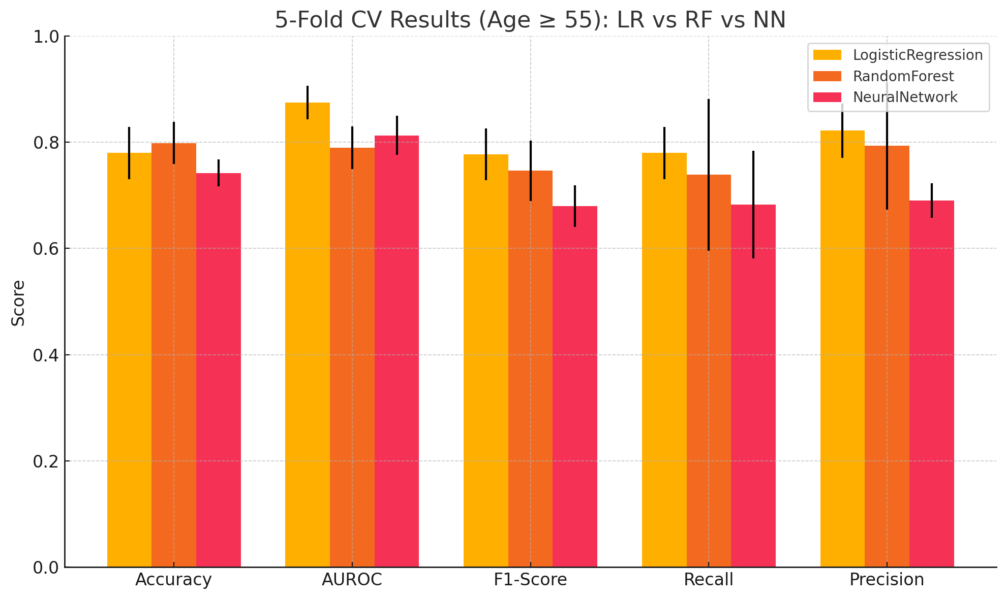
Performances: [age group >= 55]
Intro
Related Works
Methodologies
Performances
What we learned
Future Works
References

Slide 15
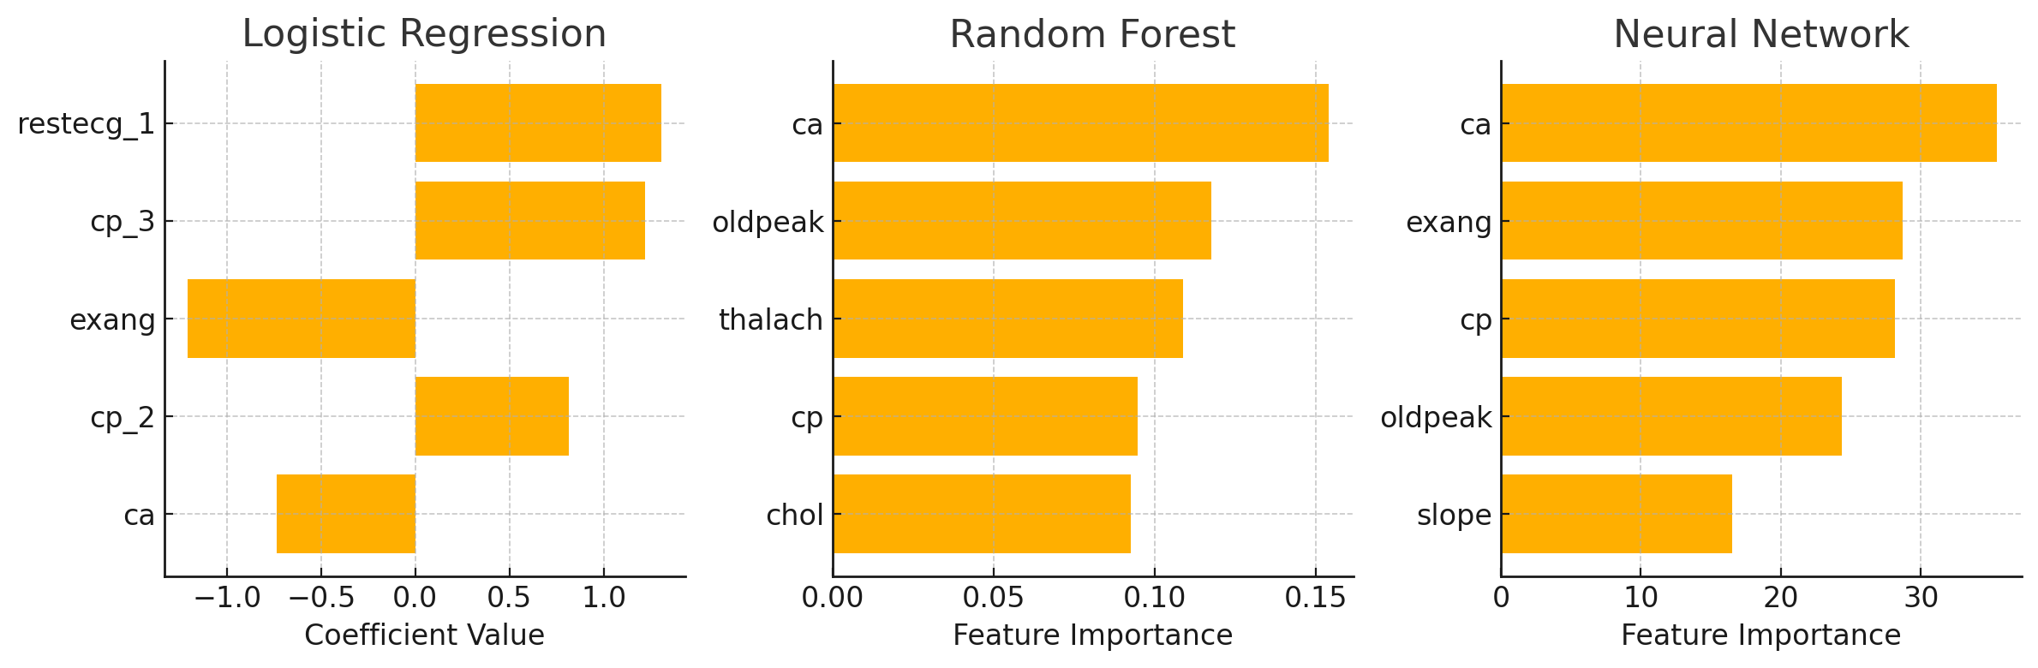
Feature importance : [age group >= 55]
Intro
Related Works
Methodologies
Performances
What we learned
Future Works
References

Slide 16


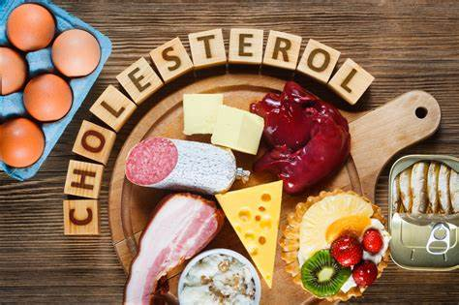
Insights from result
Intro
Related Works
Methodologies
Performances
What we learned
Future Works
References
Common features from all 3 models and what we can tell from it
Across all patients (cp = chest pain, ca = coronary artery)
Pay attention to chest pain signals > Exercise regularly, reduce smoking & drinking to reduce stress on heart
Keep coronary vessel healthy > Try Mediterranean diet (olive oil, fish, vegetables)
Younger than 55 (thalach = max heart rate, thal = heart condition scan)
Try interval training to steadily increase max achievable heart rate
Don’t miss out on annual check-ups (monitor heart condition)
55 and older (Exang = Exercise induced angina/pain, chol = cholesterol)
Avoid high‑cholesterol foods like cheese, fatty meats, dairy desserts
Try to stay active (take a walk in the part rather than sit and watch TV)
Notes:
Across all patients
Pay attention to chest pain signals. Since chest pain type (CP) is the single strongest predictor everywhere, anyone experiencing new or unusual chest discomfort should seek medical evaluation promptly
Keep coronary vessel health in mind. The number of major vessels involved (CA) consistently ranks high—so regular cardiovascular check‑ups (e.g., stress tests or CT angiography) can help detect blockages early
Younger than 55
Watch for ST‑segment changes. ST‑segment depression (Oldpeak) is especially predictive in younger adults. Simple, non‑invasive ECG screenings can catch early ischemic signs before symptoms worsen.
Mind blood disorder markers. Certain thalassemia defect types (Thal) matter here, so if you have a known hemoglobinopathy, stay on top of your specialist visits and blood tests.
55 and older
Avoid high‑cholesterol foods. Elevated cholesterol (Chol) is among the top‑5 risk factors for this group—cutting back on saturated fats (red meat, full‑fat dairy) can help reduce plaque build‑up in coronary vessels.
Stay active to keep vessels clear. Exercise‑induced angina (Exang) shows up as an important marker, so a tailored, doctor‑approved exercise plan can improve your heart’s tolerance to exertion.
Monitor ECG and chest pain. As with younger patients, both chest pain type and ST changes are key—consider regular ECGs and report any new or worsening angina symptoms.

Slide 17
Intro
Related Works
Methodologies
Performances
What we learned
Future Works
References
Lesson Learned: Impact of Dataset Quality on Model Performance
Initial Dataset
Contained more general features like hours of sleep and had inconsistencies within the patient instances ( i.e. instances of patient with intuitively bad features but not having a heart disease )
Led to unreliable predictions and inconsistent feature importance across models
Final UCI Dataset
Smaller but clean and clinically validated
Delivered more stable and accurate results across all models
Key Takeaway
Data quality matters more than quantity
Clean and unique features significantly improve model performance and reliability

Slide 18
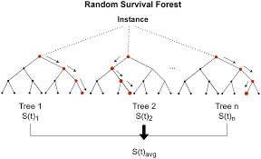

Future works
Intro
Related Works
Methodologies
Performances
What we learned
Future Works
References
Apply advanced modeling techniques like ensemble methods or healthcare-specific algorithms
2. Incorporate richer clinical data like patient history and aim for clinical interpretability
3. Test on larger & more diverse datasets for better and more trustworthy performance

Slide 19
References
Intro
Related Works
Methodologies
Performances
What we learned
Future Works
References
[1] Ahmad Ayid Ahmad and Huseyin Polat. Prediction of heart disease based on machine learning using jellyfish optimization algorithm. Diagnostics (Basel, Switzerland), 13(14):2392, 2023.
[2] Hardik Deshmukh. Heart disease uci - diagnosis & prediction, 2020. https://medium.com/data-science/heart-disease-uci-diagnosis-prediction-b1943ee835a7.
[3] Ketan Gangal. Heart disease dataset (uci), 2022. https://www.kaggle.com/datasets/ketangangal/heart-disease-dataset-uci/data.
[4] Md. Touhidul Islam, Sanjida Reza Rafa, and Md. Golam Kibria. Early prediction of heart disease using pca and hybrid genetic algorithm with k-means, 2021.
[5] David Lapp. Heart disease dataset, 2019. https://www.kaggle.com/datasets/johnsmith88/heart-disease-dataset.
[6] Redwan Karim Sony. Uci heart disease data, 2020. https://www.kaggle.com/datasets/redwankarimsony/heart-disease-data/data.

